Slide 1
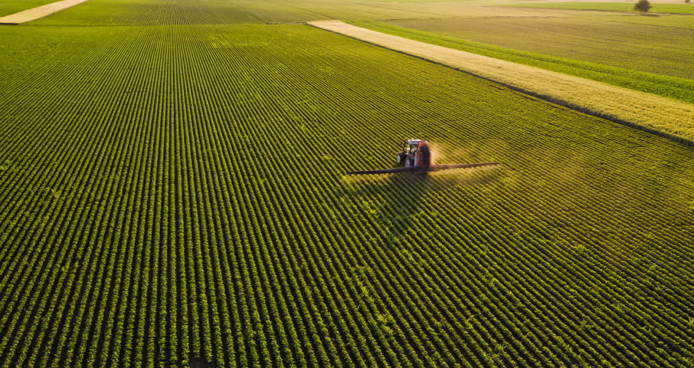

HempChain™
The Smart Solution for Industrial Hemp Tracking

Slide 2

The Problem
2018 Farm Bill
Statewide Hemp Tracking
Interstate Hemp Tracking
Bill of Lading
Chain of Custody
Certificate of Analysis

Slide 3
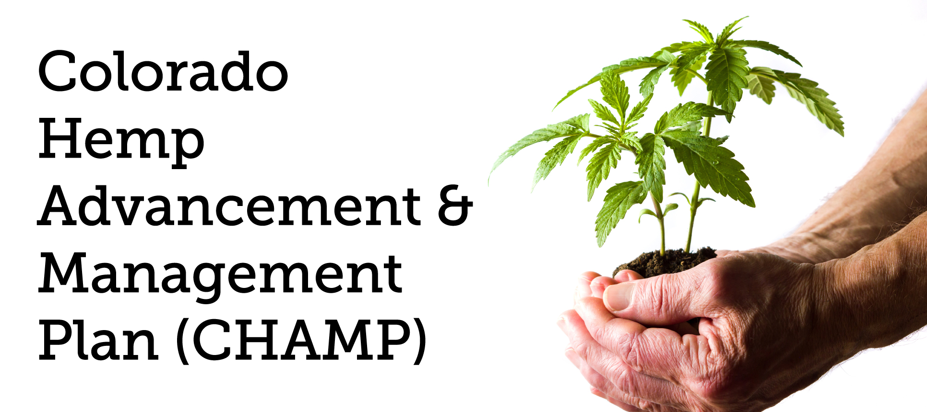
The Problem
Trust Issues
Hemp shipments stuck at Wyoming borders
Arrests
Seized Property
Colorado Law mandates that a blockchain solution must be used to track Industrial Hemp for harvest 2020

Slide 4

Solution
Solution: Life Cycle Tracking
Allows Farmers and Transporters peace of mind
Allows farmers, processors, manufacturers to know what they are buying
Allows Regulators to see what is going on inside their state lines

Slide 5

Features
Blockchain
QR Codes / Serial Numbers
Interface to interact with data
Information Held in Blockchain:
Chain of Custody – where/who?
Lab Results – legal/illegal?
Bill of Ladings – cross state lines

Slide 6
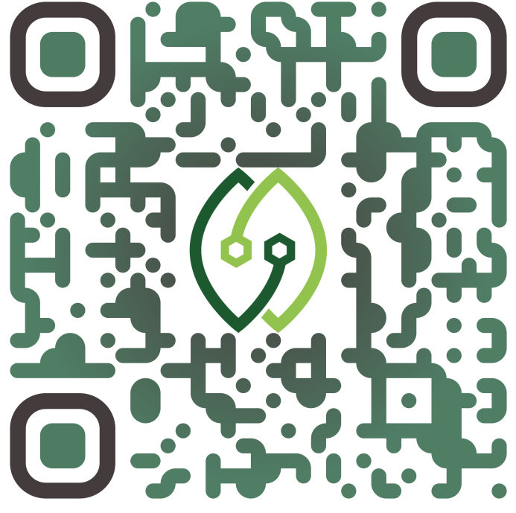
Ledger & QR Codes
Labs can be different levels of accreditation
Federally funded Labs
Mid-Grade Testing Facilities
Personal Testing

Slide 7










Our Customers
Seed
Cultivation
Testing
Transportation
Processing
Regulation
Manufacturing
Insurance
Our best customer is Regulators, as we hope to provide an ecosystem for tracking throughout the entire USA

Slide 8
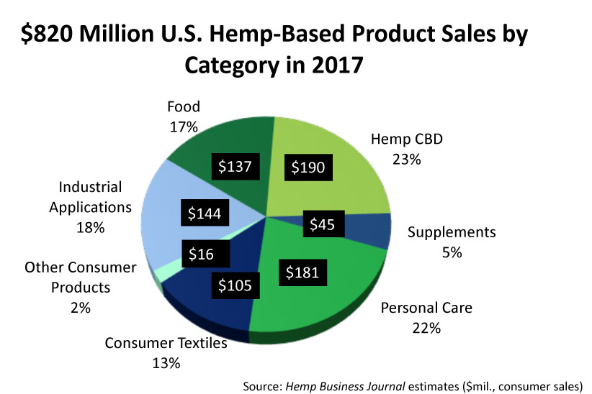
Segmentation Model
The 2019 US Hemp market: $2.1 Billion
$15 billion by 2026
12,343 active hemp cultivator licenses
544 active hemp seed licenses
1,323 active processor licenses.
Cultivation in Colorado in 2019 is expected to be more than double 2018
Hemp acreage in Kentucky will triple in 2019
Tennessee, there will be more than 12-times the acreage in 2019 compared to 2018

Slide 9




Competition
Seed-to-Sale System
Provides Business Solutions
Software Based Product
Focus on Industrial Hemp
Low Cost for Cultivators
Ease of Use for Customers
Wyoming/Colorado Interest
Blockchain Based System

Slide 10

Marketing Strategy
For Cultivators, Processors, and Manufacturers:
Live Demonstration Events
Promotional Videos
Helping/Learning in the Hemp Farming Community
Customer Acquisition:
Champ Initiative
Working/Talking with digital solutions team
Governor Polis has the final decision on what happens in Colorado with hemp
Prospective Customers:
State Agriculture Departments
Cultivators, Processors, and Manufacturers
Transportation Companies

Slide 11
Sales & Channel Strategy
Sales Strategy
Determine specific needs for state regulators
How we differ from the standard now
Show how the product would be used by a demonstration
Inform them about pricing plans that would best suit them
Consult and develop a beta per customer needs with the expanding industry
Channels
Business to Regulators and Law Enforcement:
Business to Transportation, Cultivators, Processors, and Manufacturers:

Slide 12
Revenue Model
As a company we are NOT trying to develop an individual channel but an entire ecosystem
We acknowledge this will be more difficult, but it is what the hemp industry is looking
for right now and will provide us with greater incentive
Our Two main channels are listed below:
Regulating Agencies
(Licensing Model)
Examples:
Police Officers
Departments of Agriculture
Departments of Revenue
Departments of Health
*Yearly contract based on amount of licensed users
Consumers
(2% Sales Fee)
Examples:
Transporters
Cultivators
Processors
Manufacturers
*Every monetary transaction has an associated 2% sales fee

Slide 13
Cash Flow and Profit & Loss Statement

Slide 14





Thank You
James Schuchardt & Carlton Wilcox
contactcenter@jarrowtech.com
www.JarrowTech.com

Slide 15
Q&A

Slide 16
Will you Drop Out for the business?
Yes, we can.
Yes, we will.
Customization for Companies/Agencies

Slide 17
Are you going to keep this a Wyoming Business?
Yes we will.
Customization for Companies/Agencies

Slide 18
Potential Partners?
We aren’t looking at partners as of right now.
If we were, they would be development teams and blockchain organizations.
Customization for Companies/Agencies

Slide 19
Mobile App Team: A team of about 5 people to help with building/maintaining our different versions for customers. Database Dev Team: A team of about 8 people to help build smart contracts/maintain connections/develop APIs. Website Design Team: A team of about 4 people to develop a good website that looks great and has functionality with our databases. Security Testing: A team of about 2-4 people to constantly try and break every single part of our system in order to improve our security and be ahead of malicious actors.
What kind of employment would you provide?

Slide 20
What kind of employment would you provide?
Sales Team: A team of about 6 people to help with marketing, public relations, and contact potential clients. Government Relations Team: A team of about 4 people to maintain communications with government authorities and to aid in contract building/negotiation.
Customer Support: A team of about 4 people to start, this team will take in information from consumers and actors in order to provide information to the different teams.

Slide 21
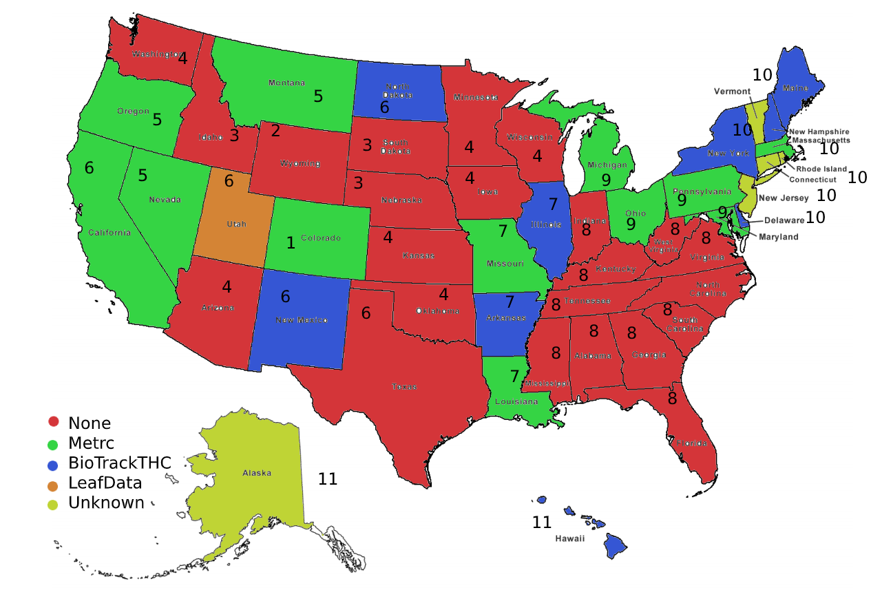
JarrowTech’s Stages of Expansion

